Slide 1
Introduction to the Fourier Transform
Prof. Suresh Pabboju

Slide 2
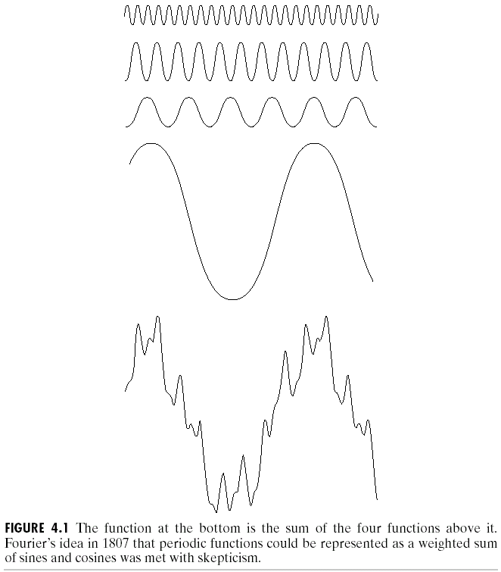
Image Enhancement in the
Frequency Domain
Prof. Suresh Pabboju

Slide 3
Fundamentals
Fourier: a periodic function can be represented by the sum of sines/cosines of different frequencies, multiplied by a different coefficient (Fourier series)
Non-periodic functions can also be represented as the integral of sines/cosines multiplied by weighing function (Fourier transform)
Prof. Suresh Pabboju

Slide 4
Discrete Fourier Transform
A continuous function f(x) is discretized into a sequence:
by taking N or M samples x units apart.
Prof. Suresh Pabboju

Slide 5
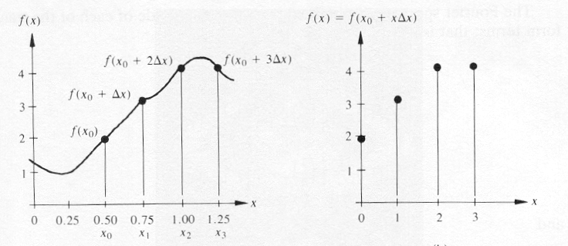
Discrete Fourier Transform
Prof. Suresh Pabboju

Slide 6
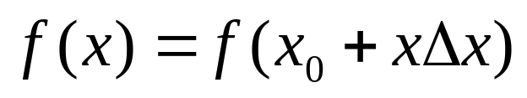
Discrete Fourier Transform
Where x assumes the discrete values
(0,1, 2, 3,…, M-1) then
The sequence {f(0),f(1),f(2),…f(M-1)} denotes any M uniformly spaced samples from a corresponding continuous function.
Prof. Suresh Pabboju

Slide 7
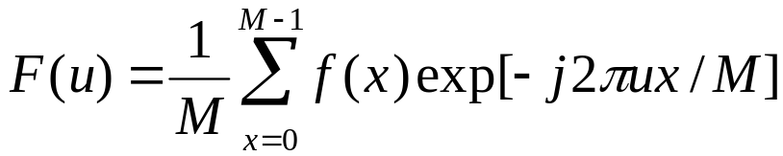
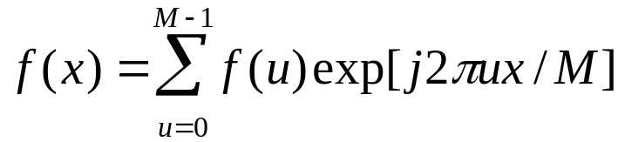
Discrete Fourier Transform
The discrete Fourier transform pair that applies to sampled functions is given by:
For u=0,1,2,…,M-1
and
For x=0,1,2,…,M-1
Prof. Suresh Pabboju

Slide 8
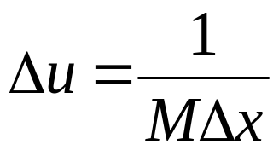
Discrete Fourier Transform
The values u = 0, 1, 2, …, M-1 correspond to samples of the continuous transform at values 0, u, 2u, …, (M-1)u.
i.e. F(u) represents F(uu), where:
Prof. Suresh Pabboju

Slide 9
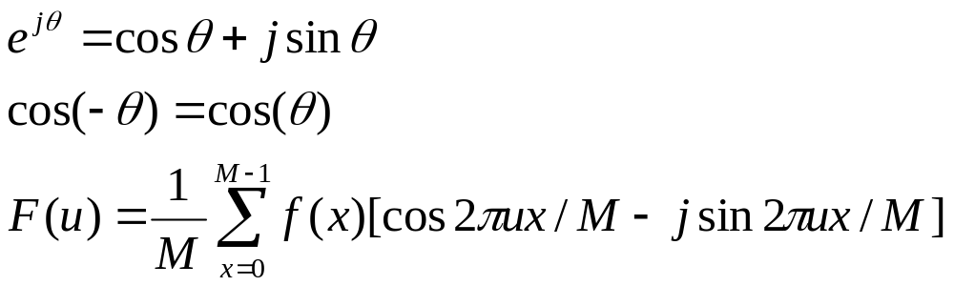
Details
Each term of the FT (F(u) for every u) is composed of the sum of all values of f(x)
Prof. Suresh Pabboju

Slide 10
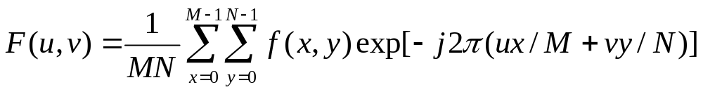
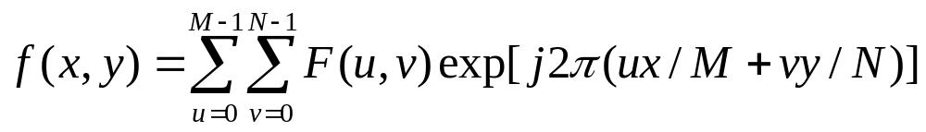
Discrete Fourier Transform
In a 2-variable case, the discrete FT pair is:
For u=0,1,2,…,M-1 and
v=0,1,2,…,N-1
AND:
For x=0,1,2,…,M-1 and
y=0,1,2,…,N-1
Prof. Suresh Pabboju

Slide 11
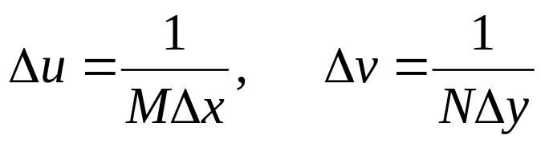
Discrete Fourier Transform
Sampling of a continuous function is now in a 2-D grid (x, y divisions).
The discrete function f(x,y) represents samples of the function f(x₀+xx, y₀+yy) for x=0,1,2,…,M-1 and y=0,1,2,…,N-1.
Prof. Suresh Pabboju

Slide 12
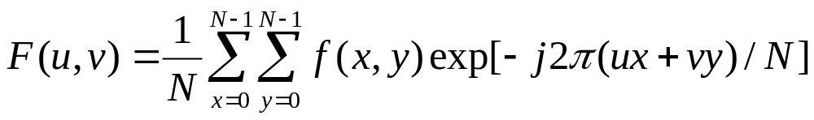
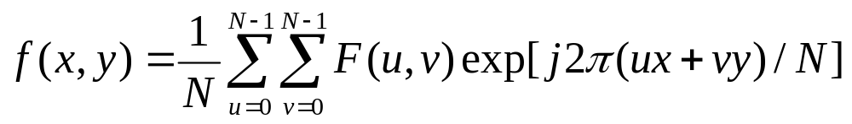
Discrete Fourier Transform
When images are sampled in a square array, M=N and the FT pair becomes:
For u,v=0,1,2,…,N-1
AND:
For x,y=0,1,2,…,N-1
Prof. Suresh Pabboju

Slide 13
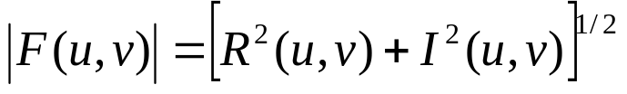
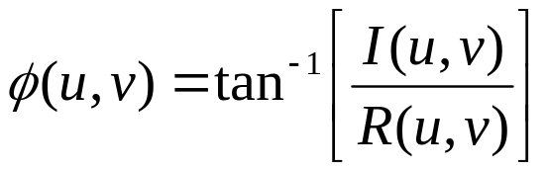
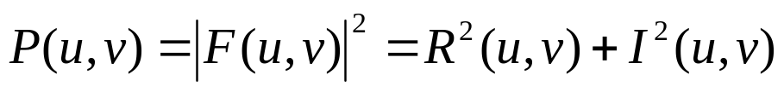
Introduction to the Fourier Transform
Fourier spectrum:
Phase:
Power spectrum:
Prof. Suresh Pabboju

Slide 14
Image Enhancement in
Frequency Domain
Notes:
Department of Computer Engineering, CMU

Slide 15
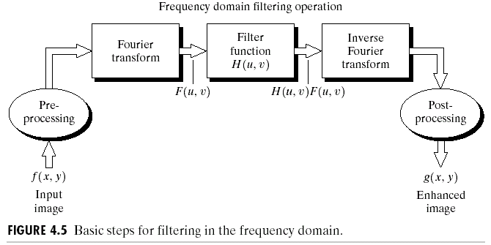
Basic steps for filtering in the frequency domain
Prof. Suresh Pabboju

Slide 16
Basics of filtering in the frequency domain
multiply the input image by (-1)^{x+y} to center the transform to u = M/2 and v = N/2 (if M and N are even numbers, then the shifted coordinates will be integers)
computer F(u,v), the DFT of the image from (1)
multiply F(u,v) by a filter function H(u,v)
compute the inverse DFT of the result in (3)
obtain the real part of the result in (4)
multiply the result in (5) by (-1)^{x+y} to cancel the multiplication of the input image.
for u=0,1,2,…, M-1 and
v=0,1,2,…, N-1
for x=0,1,2,…, M-1 and
y=0,1,2,…, N-1
Prof. Suresh Pabboju

Slide 17
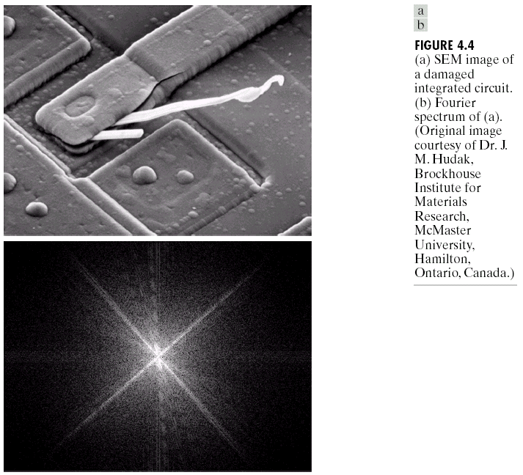
Image Enhancement in the
Frequency Domain
Prof. Suresh Pabboju

Slide 18
Basic Properties
Common practice:
F(0,0) is at u=M/2 and v=N/2
Shifts the origin of F(u,v) to (M/2, N/2), i.e. the center of MxN of the 2-D DFT (frequency rectangle)
Frequency rectangle:
from u=0 to u=M-1, and v=0 to v=N-1
(u,v integers, M,N even numbers)
In computers:
summations are from u=1 to M and v=1 to N
center of transform: u=(M/2) +1 and v=(N/2) +1
Prof. Suresh Pabboju

Slide 19
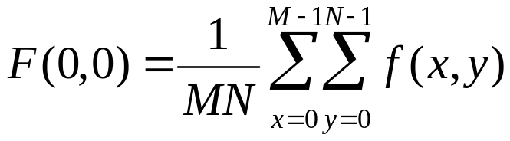
Basic Properties
Value of transform at (u,v)=(0,0) is
which means that the value of FT at the origin
= the average gray level of the image
FT is also conjugate summetric:
F(u,v)=F*(-u,-v)
so |F(u,v)|=|F(-u,-v)|
which means that the FT spectrum is symmetric.
Prof. Suresh Pabboju

Slide 20
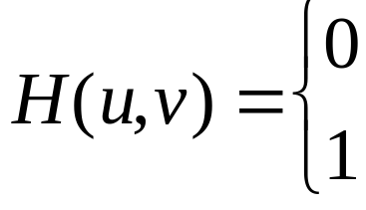
Basic Filters
To force the average value of an image to 0:
  F(0,0) gives the average value of an image
  then, since F(0,0)=0, take the inverse
if (u,v) = M/2, N/2
otherwise
Prof. Suresh Pabboju

Slide 21
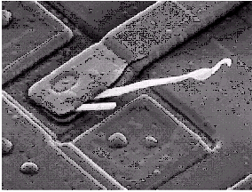
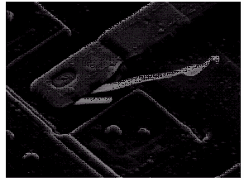
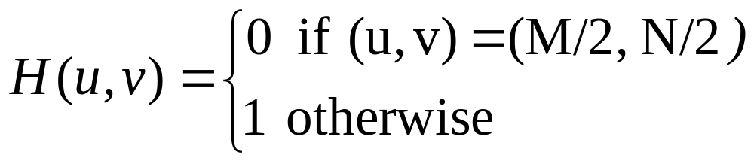
Notch filter
this filter is to force the F(0,0) which is the average value of an image
(dc component of the spectrum)
the output has prominent edges
in reality the average of the displayed image can’t be zero as it needs to have negative gray levels. the output image needs to scale the gray level
Prof. Suresh Pabboju

Slide 22
Enhancement in the Frequency Domain
Types of enhancement that can be done:
  Lowpass filtering: reduce the high-frequency content -- blurring or smoothing
  Highpass filtering: increase the magnitude of high-frequency components relative to low-frequency components -- sharpening.
Prof. Suresh Pabboju

Slide 23
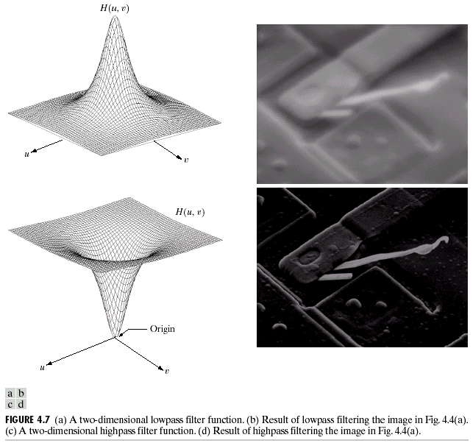
Image Enhancement in the
Frequency Domain
Prof. Suresh Pabboju

Slide 24
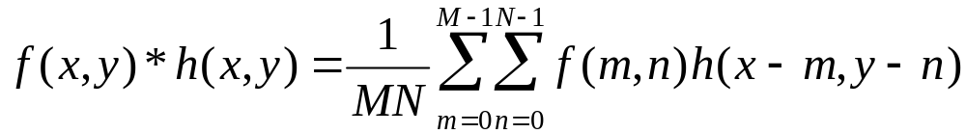
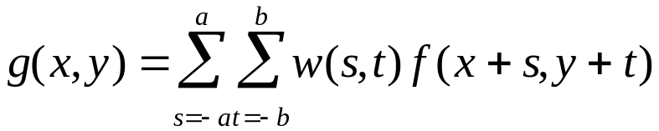
Correspondence – Filtering in the Spatial and Frequency Domains
Discrete convolution of two functions f(x,y) and h(x,y) of size MxN is defined as
Convolution Theorem
f(x,y)*h(x,y)⇔F(u,v)H(u,v)
f(x,y)h(x,y)⇔F(u,v)*H(u,v)
Prof. Suresh Pabboju

Slide 25
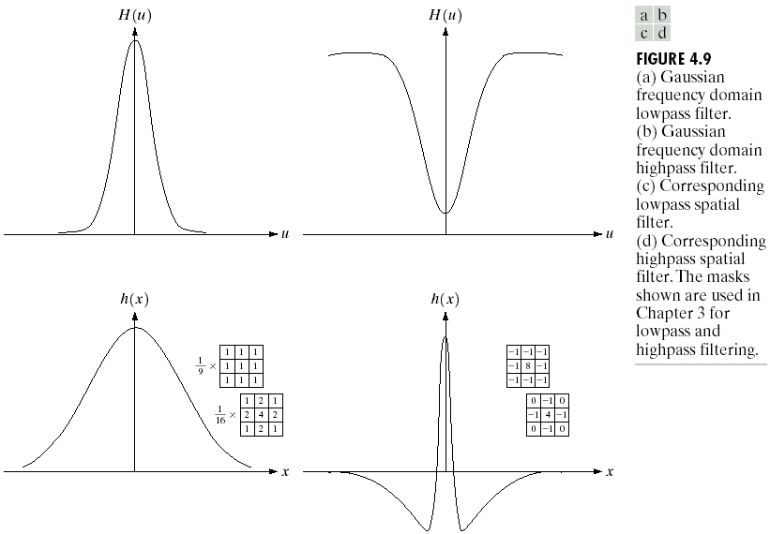
Correspondence between filter in spatial and frequency domains
Prof. Suresh Pabboju

Slide 26
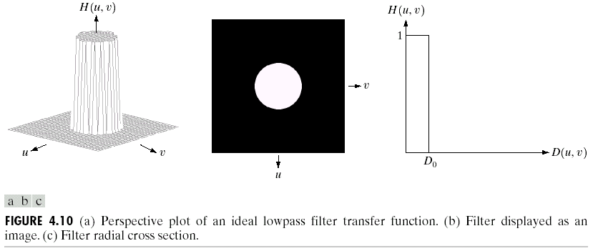
Smoothing Frequency-domain filters: Ideal Lowpass filter
Prof. Suresh Pabboju

Slide 27
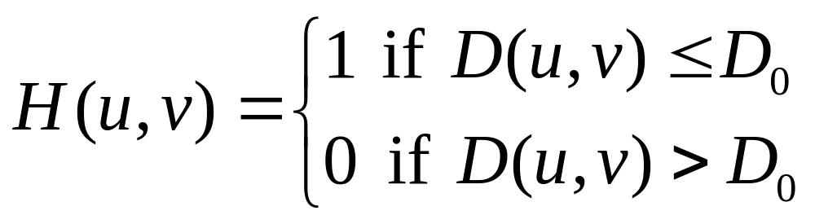
Ideal Low Pass Filter (cont…)
The transfer function for the ideal low pass filter can be given as:
where D(u,v) is given as:

Slide 28
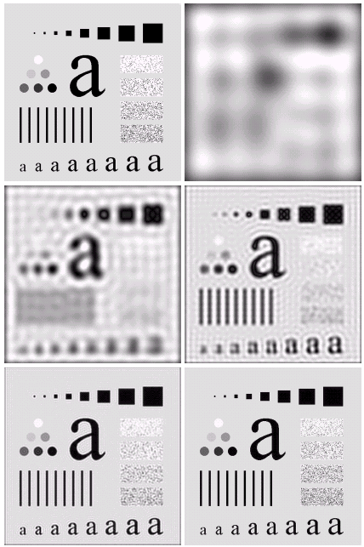

Result of ILPF
Prof. Suresh Pabboju

Slide 29
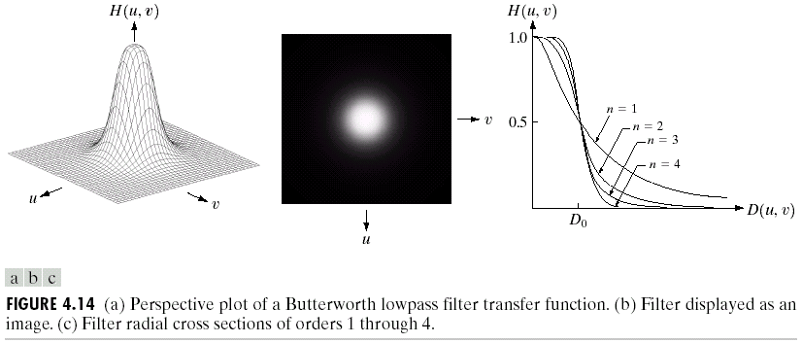
Butterworth Lowpass Filter: BLPF
Prof. Suresh Pabboju

Slide 30
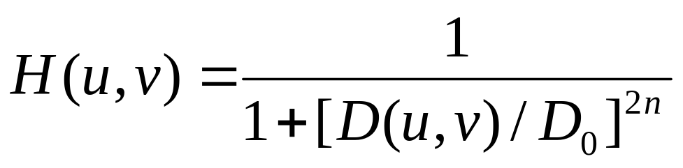
Butterworth Lowpass Filters
The transfer function of a Butterworth lowpass filter of order n with cutoff frequency at distance D₀ from the origin is defined as:

Slide 31
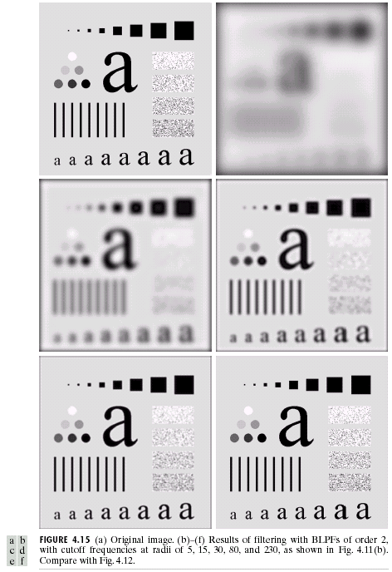
Butterworth Lowpass Filter (cont…)
Result of filtering with Butterworth filter of order 2 and cutoff radius 5
Original
image
Result of filtering with Butterworth filter of order 2 and cutoff radius 15
Result of filtering with Butterworth filter of order 2 and cutoff radius 30
Result of filtering with Butterworth filter of order 2 and cutoff radius 80
Result of filtering with Butterworth filter of order 2 and cutoff radius 230

Slide 32
Butterworth Lowpass Filter (cont…)
Original
image
Result of filtering with Butterworth filter of order 2 and cutoff radius 5

Slide 33
Butterworth Lowpass Filter (cont…)
Result of filtering with Butterworth filter of order 2 and cutoff radius 15

Slide 34
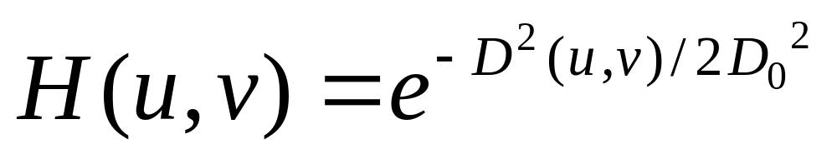
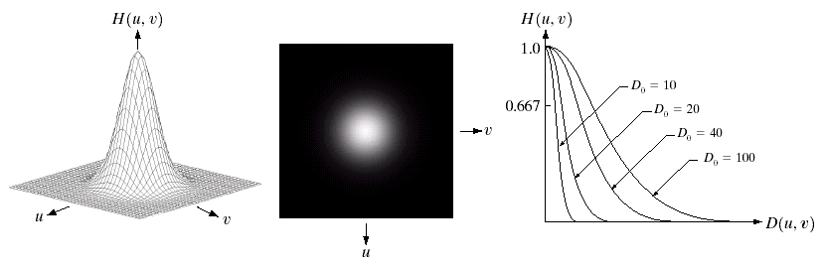
Gaussian Lowpass Filters
The transfer function of a Gaussian lowpass filter is defined as:

Slide 35
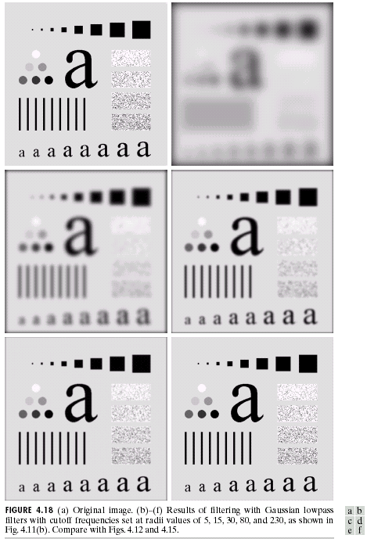
Gaussian Lowpass Filters (cont…)
Result of filtering with Gaussian filter with cutoff radius 5
Original
image
Result of filtering with Gaussian filter with cutoff radius 15
Result of filtering with Gaussian filter with cutoff radius 30
Result of filtering with Gaussian filter with cutoff radius 85
Result of filtering with Gaussian filter with cutoff radius 230

Slide 36
Lowpass Filters Compared
Result of filtering with ideal low pass filter of radius 15
Result of filtering with Butterworth filter of order 2 and cutoff radius 15
Result of filtering with Gaussian filter with cutoff radius 15

Slide 37
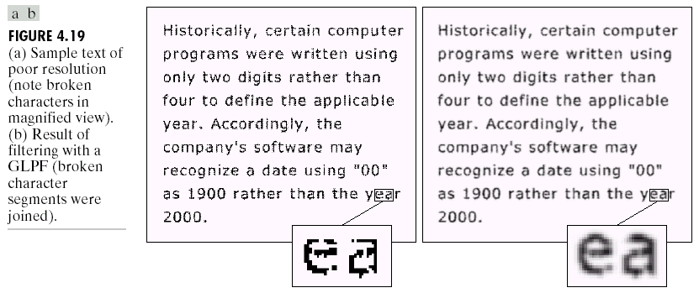
Example
Prof. Suresh Pabboju

Slide 38
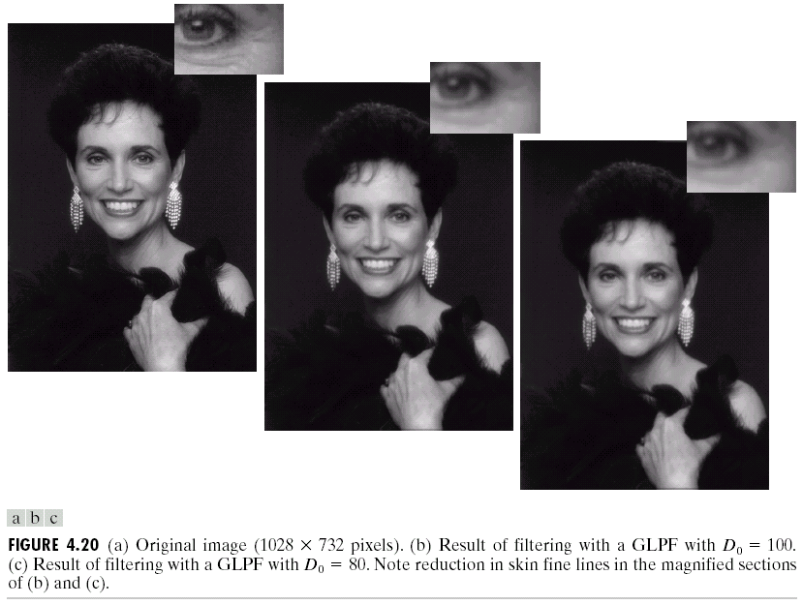
Example
Prof. Suresh Pabboju

Slide 39
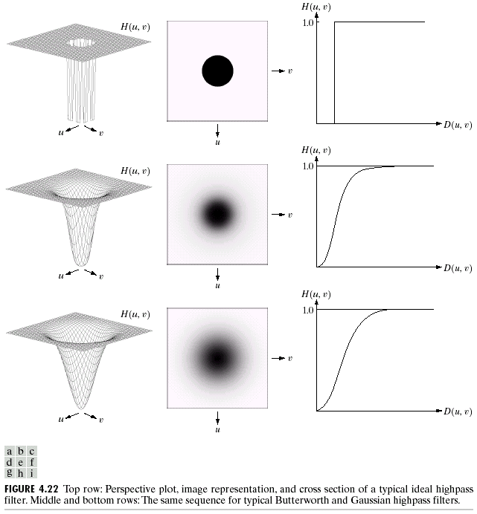
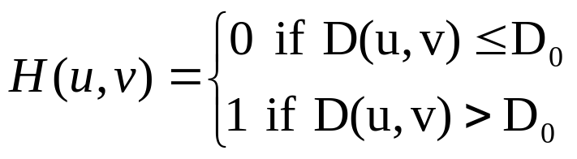
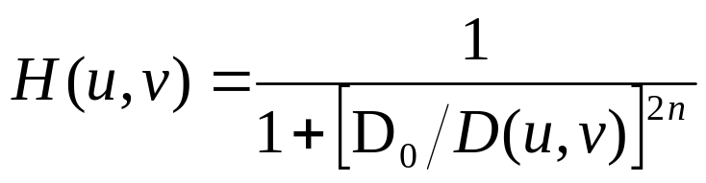
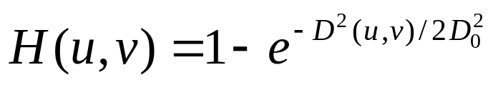
Sharpening Frequency Domain Filter:
Ideal highpass filter
Butterworth highpass filter
Gaussian highpass filter
Prof. Suresh Pabboju

Slide 40
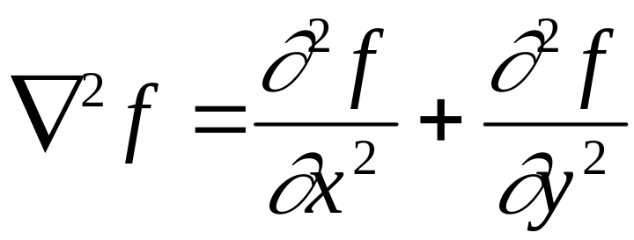
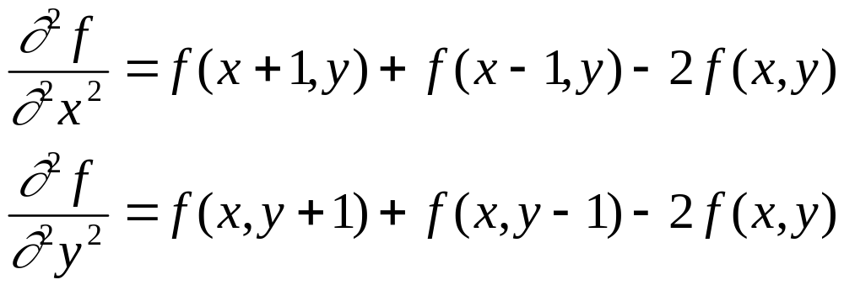
Laplacian (recap)

Slide 41
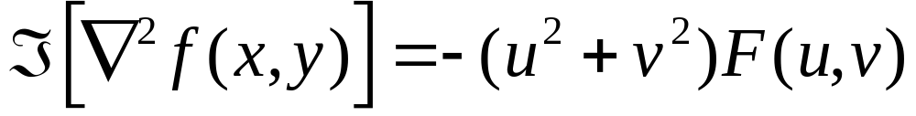

Laplacian in the FD
It can be shown that:
The Laplacian can be implemented in the FD by using the filter
FT pair:

Slide 42
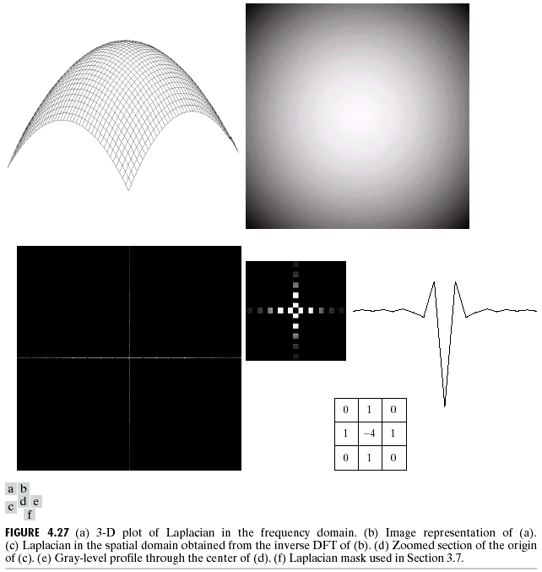
Laplacian in the Frequency domain
Prof. Suresh Pabboju

Slide 43
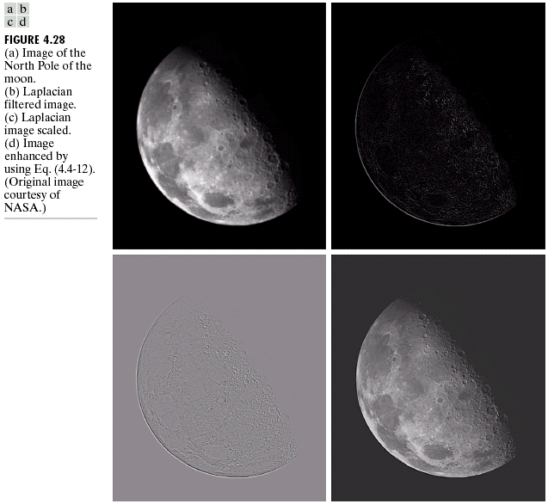
Example: Laplacian filtered image
Prof. Suresh Pabboju

Slide 44
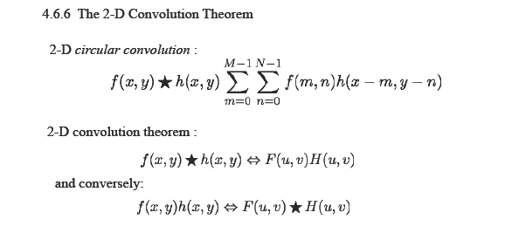
Convolution Theorem
Prof. Suresh Pabboju

